Slide 1
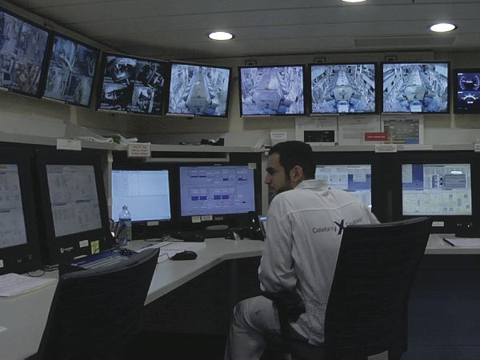
Design of Goods and Services
5
PowerPoint presentation to accompany
Heizer, Render, Munson
Operations Management, Thirteenth Edition, Global Edition
Principles of Operations Management, Eleventh Edition
PowerPoint slides by Jeff Heyl

Slide 2
Outline
Global Company Profile: Regal Marine
Goods and Services Selection
Generating New Products
Product Development
Issues for Product Design
Product Development Continuum

Slide 3
Outline - Continued
Defining a Product
Documents for Production
Service Design
Application of Decision Trees to Product Design
Transition to Production

Slide 4
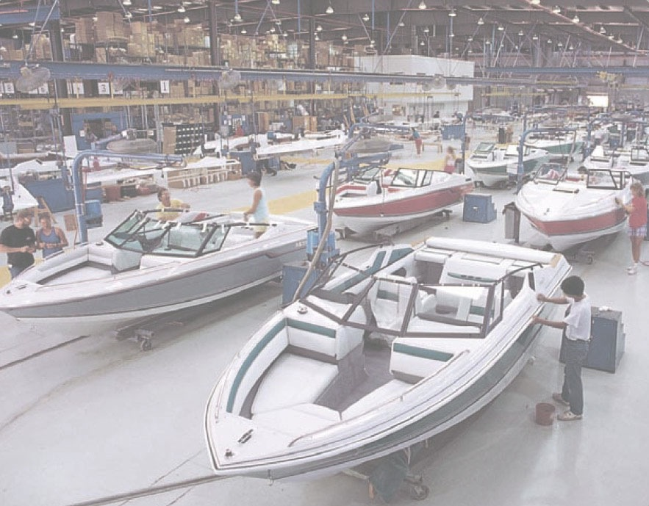
Regal Marine
Global market
3-dimensional CAD system
Reduced product development time
Reduced problems with tooling
Reduced problems in production
Assembly line production
JIT

Slide 5
Learning Objectives
When you complete this chapter you should be able to :
5.1 Define product life cycle
5.2 Describe a product development system
5.3 Build a house of quality
5.4 Explain how time-based competition is implemented by OM

Slide 6
Learning Objectives
When you complete this chapter you should be able to :
5.5 Describe how goods and services are defined by OM
5.6 Describe the documents needed for production
5.7 Apply decision trees to product issues

Slide 7
Goods and Services Selection
Organizations exist to provide goods or services to society
Great products are the key to success
Top organizations typically focus on core products
Customers buy satisfaction, not just a physical good or particular service
Fundamental to an organization's strategy with implications throughout the operations function

Slide 8
Goods and Services Selection
Limited and predicable life cycles requires constantly looking for, designing, and developing new products
Utilize strong communication among customer, product, processes, and suppliers
New products generate substantial revenue

Slide 9
Goods and Services Selection
50% –
40% –
30% –
20% –
10% –
0% –
The higher the percentage of sales from the last 5 years, the more likely the firm is to be a leader.
Percentage of sales from new products
Figure 5.1
Industry leader
Top third
Middle third
Bottom third
Position of firm in its industry

Slide 10
Product Decision
The objective of the product decision is to develop and implement a product strategy that meets the demands of the marketplace with a competitive advantage

Slide 11
Product Strategy Options
Differentiation
Shouldice Hospital
Low cost
Taco Bell
Rapid response
Toyota

Slide 12
Product Life Cycles
May be any length from a few days to decades
The operations function must be able to introduce new products successfully

Slide 13
Product Life Cycle
Cost of development and production
$
Sales revenue
Loss
Profit
Loss
Introduction Growth Maturity Decline
Figure 5.2

Slide 14
Life Cycle and Strategy
Introductory Phase
Fine tuning may warrant unusual expenses for
Research
Product development
Process modification and enhancement
Supplier development

Slide 15
Product Life Cycle
Growth Phase
Product design begins to stabilize
Effective forecasting of capacity becomes necessary
Adding or enhancing capacity may be necessary

Slide 16
Product Life Cycle
Maturity Phase
Competitors now established
High volume, innovative production may be needed
Improved cost control, reduction in options, paring down of product line

Slide 17
Product Life Cycle
Decline Phase
Unless product makes a special contribution to the organization, management must plan to terminate offering

Slide 18
Product Life Cycle Costs
100 –
80 –
60 –
40 –
20 –
0 –
Costs committed
Costs incurred
Percent of total cost
Ease of change
Concept Detailed Manufacturing Distribution,
design design service,
prototype and disposal

Slide 19
Product-by-Value Analysis
Lists products in descending order of their individual dollar contribution to the firm
Lists the total annual dollar contribution of the product
Helps management evaluate alternative strategies

Slide 20
Generating New Products
Understanding the customer
Economic change
Sociological and demographic change
Technological change
Political and legal change
Market practice, professional standards, suppliers, distributors

Slide 21
Product Development Stages
Concept
Feasibility
Figure 5.3
Customer Requirements
Functional Specifications
Product Specifications
Scope for design and engineering teams
Scope of product development team
Design Review
Test Market
Introduction
Evaluation

Slide 22
Quality Function Deployment
Quality function deployment (QFD)
Determine what will satisfy the customer
Translate those customer desires into the target design
House of quality
Utilize a planning matrix to relate customer wants to how the firm is going to meet those wants

Slide 23
Quality Function Deployment
Identify customer wants
Identify how the good/service will satisfy customer wants
Relate customer wants to product hows
Identify relationships between the firm’s hows
Develop our importance ratings
Evaluate competing products
Compare performance to desirable technical attributes

Slide 24
QFD House of Quality
Interrelationships
Customer importance ratings
How to satisfy
customer wants
What the customer
wants
Relationship
matrix
Competitive assessment
Target values
Weighted rating
Technical
evaluation
Notes:
1

Slide 25
House of Quality Example
Your team has been charged with designing a new camera for Great Cameras, Inc.
The first action is to construct a House of Quality

Slide 26
House of Quality Example
Interrelationships
How to Satisfy
Customer Wants
What the Customer
Wants
Relationship
Matrix
Analysis of
Competitors
Technical
Attributes and
Evaluation
What the customer wants
Customer
importance
rating
(5 = highest)
Lightweight 3
Easy to use 4
Reliable 5
Easy to hold steady 2
High resolution 1

Slide 27
House of Quality Example
Interrelationships
How to Satisfy
Customer Wants
What the Customer
Wants
Relationship
Matrix
Analysis of
Competitors
Technical
Attributes and
Evaluation
Low electricity requirements
Aluminum components
Auto focus
Auto exposure
High number of pixels
Ergonomic design
How to Satisfy
Customer Wants

Slide 28
House of Quality Example
Interrelationships
How to Satisfy
Customer Wants
What the Customer
Wants
Relationship
Matrix
Analysis of
Competitors
High relationship
Medium relationship
Low relationship
Technical
Attributes and
Evaluation
Lightweight 3
Easy to use 4
Reliable 5
Easy to hold steady 2
High resolution 1
Relationship matrix

Slide 29
House of Quality Example
Interrelationships
How to Satisfy
Customer Wants
What the Customer
Wants
Relationship
Matrix
Analysis of
Competitors
Technical
Attributes and
Evaluation
Low electricity requirements
Aluminum components
Auto focus
Auto exposure
High number of pixels
Ergonomic design
Relationships between the things we can do

Slide 30
House of Quality Example
Interrelationships
How to Satisfy
Customer Wants
What the Customer
Wants
Relationship
Matrix
Analysis of
Competitors
Technical
Attributes and
Evaluation
Lightweight 3
Easy to use 4
Reliable 5
Easy to hold steady 2
High resolution 1
Our importance ratings 22 9 27 27 32 25
Weighted rating

Slide 31
House of Quality Example
Interrelationships
How to Satisfy
Customer Wants
What the Customer
Wants
Relationship
Matrix
Analysis of
Competitors
Technical
Attributes and
Evaluation
Company A
Company B
How well do competing products meet customer wants
Lightweight 3
Easy to use 4
Reliable 5
Easy to hold steady 2
High resolution 1
G P
G P
F G
G P
P P
Our importance ratings 22 5

Slide 32
House of Quality Example
Interrelationships
How to Satisfy
Customer Wants
What the Customer
Wants
Relationship
Matrix
Analysis of
Competitors
Technical
Attributes and
Evaluation
2 circuits
Failure 1 per 10,000
Panel ranking
Target values
(Technical attributes)
75%
2’ to ∞
0.5 A
Company A 0.7 60% yes 1 ok G
Company B 0.6 50% yes 2 ok F
Us 0.5 75% yes 2 ok G
Technical evaluation

Slide 33
House of Quality Example
Low electricity requirements
Aluminum components
Auto focus
Auto exposure
High number of pixels
Ergonomic design
Company A
Company B
Completed House of Quality
Lightweight 3
Easy to use 4
Reliable 5
Easy to hold steady 2
High resolution 1
Our importance ratings
G P
G P
F G
G P
P P
22 9 27 27 32 25
0.5 A
75%
2’ to ∞
2 circuits
Failure 1 per 10,000
Panel ranking
Target values
(Technical attributes)
Company A 0.7 60% yes 1 ok G
Company B 0.6 50% yes 2 ok F
Us 0.5 75% yes 2 ok G
Technical evaluation

Slide 34
House of Quality Sequence
Deploying resources through the organization in response to customer requirements
Quality plan
Production process
Specific components
Production process
House 4
Design characteristics
Specific components
House 3
Design characteristics
House 2
Customer requirements
House 1
Figure 5.4

Slide 35
Organizing for Product Development
Traditionally – distinct departments
Duties and responsibilities are defined
Difficult to foster forward thinking
A Champion
Product manager drives the product through the product development system and related organizations

Slide 36
Organizing for Product Development
Team approach
Cross functional – representatives from all disciplines or functions
Product development teams, design for manufacturability teams, value engineering teams
Japanese “whole organization” approach
No organizational divisions

Slide 37
Organizing for Product Development
Product development teams
Market requirements to product success
Cross-functional teams often involving vendors
Open, highly participative environment

Slide 38
Organizing for Product Development
Concurrent engineering
Simultaneous performance of product development stages
Speedier product development
Facilitated by cross-functional teams

Slide 39
Manufacturability and Value Engineering
Benefits:
Reduced complexity of the product
Reduction of environmental impact
Additional standardization of components
Improvement of functional aspects of the product
Improved job design and job safety
Improved maintainability (serviceability) of the product
Robust design

Slide 40
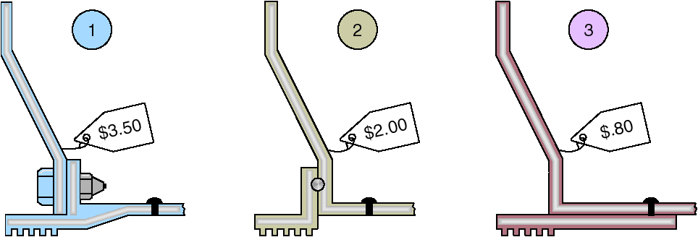
Cost Reduction of a Bracket via Value Engineering
Figure 5.5

Slide 41
Issues for Product Design
Robust design
Modular design
Computer-aided design (CAD)
Computer-aided manufacturing (CAM)
Virtual reality technology
Value analysis
Sustainability and Life Cycle Assessment (LCA)

Slide 42
Robust Design
Product is designed so that small variations in production or assembly do not adversely affect the product
Typically results in lower cost and higher quality

Slide 43
Modular Design
Products designed in easily segmented components
Adds flexibility to both production and marketing
Improved ability to satisfy customer requirements

Slide 44

Computer Aided Design (CAD)
Using computers to design products and prepare engineering documentation
Shorter development cycles, improved accuracy, lower cost
Information and designs can be deployed worldwide

Slide 45
Extensions of CAD
3D Object Modeling
Small prototype development
Design for Manufacturing and Assembly (DFMA)
Solve manufacturing problems during the design stage
CAD through the Internet
International data exchange through STEP
3D printing

Slide 46
Computer-Aided Manufacturing (CAM)
Utilizing specialized computers and program to control manufacturing equipment
Often driven by the CAD system (CAD/CAM)
Additive manufacturing
Extension of CAD that builds products by adding material layer upon layer

Slide 47
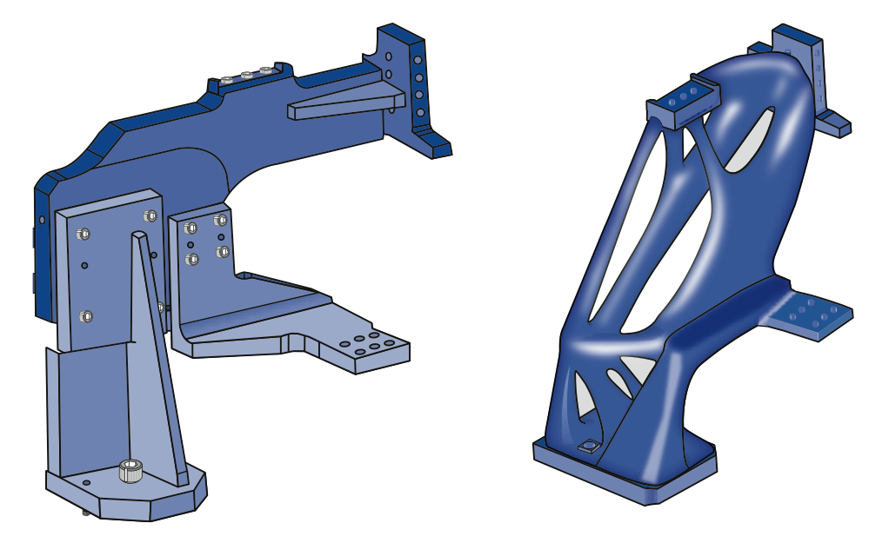
Additive Manufacturing
Figure 5.5

Slide 48
Benefits of CAD/CAM
Product quality
Shorter design time
Production cost reductions
Database availability
New range of capabilities

Slide 49
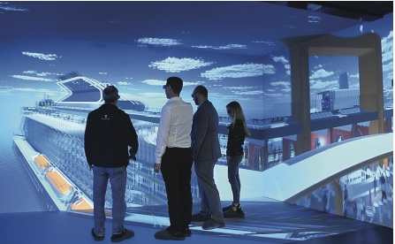
Virtual Reality Technology
A visual form of communication in which images substitute for reality and typically allow the user to respond interactively
Allows people to ‘see’ the finished design before a physical model is built
Very effective in large-scale designs such as plant layout

Slide 50
Augmented Reality
The integration of digital information with the user's environment in real time
Digital information or images superimposed on an existing image
Useful in product design, assembly and maintenance operations, tool or specification information

Slide 51
Value Analysis
Focuses on design improvement during production
Seeks improvements leading either to a better product or a product that can be produced more economically with less environmental impact

Slide 52
Sustainability and Life Cycle Assessment (LCA)
Sustainability means meeting the needs of the present without compromising the ability of future generations to meet their needs
LCA is a formal evaluation of the environmental impact of a product

Slide 53
Product Development Continuum
Product life cycles are becoming shorter and the rate of technological change is increasing
Developing new products faster can result in a competitive advantage
Time-based competition

Slide 54
Product Development Continuum
External Development Strategies
Alliances
Joint ventures
Purchase technology or expertise by acquiring the developer
Figure 5.6
Internal Development Strategies
Migrations of existing products
Enhancements to existing products
New internally developed products
Internal Cost of product development Shared
Lengthy Speed of product development Rapid and/ or Existing
High Risk of product development Shared

Slide 55
Product Development Continuum
Purchasing technology by acquiring a firm
Speeds development
Issues concern the fit between the acquired organization and product and the host
Joint Ventures
Both organizations learn
Risks are shared

Slide 56
Product Development Continuum
Alliances
Cooperative agreements between independent organizations
Useful when technology is developing
Reduces risks

Slide 57
Defining a Product
First definition is in terms of functions
Rigorous specifications are developed during the design phase
Manufactured products will have an engineering drawing
Bill of material (BOM) lists the components of a product

Slide 58
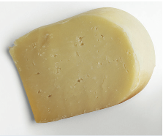
Monterey Jack Cheese
(a) U.S. grade AA. Monterey cheese shall conform to the following requirements:
(1) Flavor. Is fine and highly pleasing, free from undesirable flavors and odors. May possess a very slight acid or feed flavor.
(2) Body and texture. A plug drawn from the cheese shall be reasonably firm. It shall have numerous small mechanical openings evenly distributed throughout the plug. It shall not possess sweet holes, yeast holes, or other gas holes.
(3) Color. Shall have a natural, uniform, bright and attractive appearance.
(4) Finish and appearance—bandaged and paraffin-dipped. The rind shall be sound, firm, and smooth, providing a good protection to the cheese.
Code of Federal Regulation, Parts 53 to 109, General Service Administration

Slide 59
Product Documents
Engineering drawing
Shows dimensions, tolerances, and materials
Shows codes for Group Technology
Bill of Material
Lists components, quantities and where used
Shows product structure

Slide 60
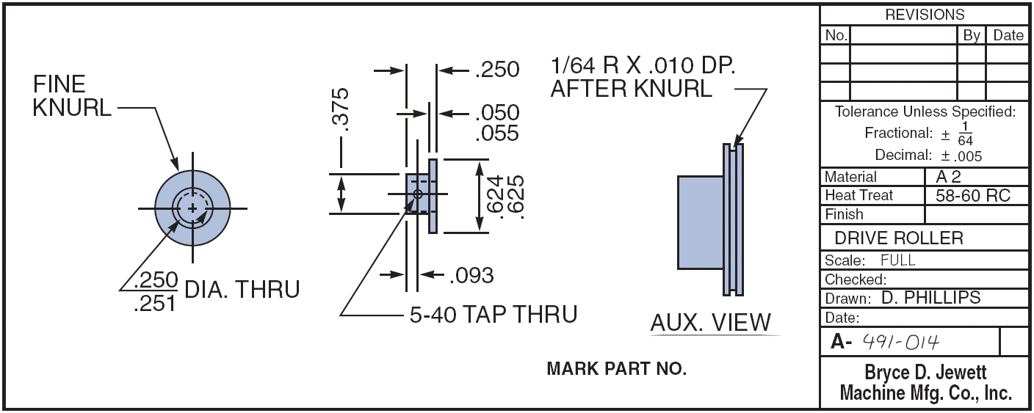
Engineering Drawings
Figure 5.8

Slide 61
Bills of Material
BOM for a Panel Weldment
NUMBER DESCRIPTION QTY
A 60-71 PANEL WELDM’T 1
A 60-7 LOWER ROLLER ASSM. 1
R 60-17 ROLLER 1
R 60-428 PIN 1
P 60-2 LOCKNUT 1
A 60-72 GUIDE ASSM. REAR 1
R 60-57-1 SUPPORT ANGLE 1
A 60-4 ROLLER ASSM. 1
02-50-1150 BOLT 1
A 60-73 GUIDE ASSM. FRONT 1
A 60-74 SUPPORT WELDM’T 1
R 60-99 WEAR PLATE 1
02-50-1150 BOLT 1
Figure 5.9 (a)

Slide 62
Bills of Material
Hard Rock Cafe’s Hickory BBQ Bacon Cheeseburger
DESCRIPTION QTY
Bun 1
Hamburger patty 8 oz.
Cheddar cheese 2 slices
Bacon 2 strips
BBQ onions 1/2 cup
Hickory BBQ sauce 1 oz.
Burger set
Lettuce 1 leaf
Tomato 1 slice
Red onion 4 rings
Pickle 1 slice
French fries 5 oz.
Seasoned salt 1 tsp.
11-inch plate 1
HRC flag 1
Figure 5.9 (b)

Slide 63
Make-or-Buy Decisions
Produce components themselves or buy from an outside source
Variations in
Quality
Cost
Delivery schedules
Critical to product definition

Slide 64
Group Technology
Parts grouped into families with similar characteristics
Coding system describes processing and physical characteristics
Part families can be produced in dedicated manufacturing cells

Slide 65
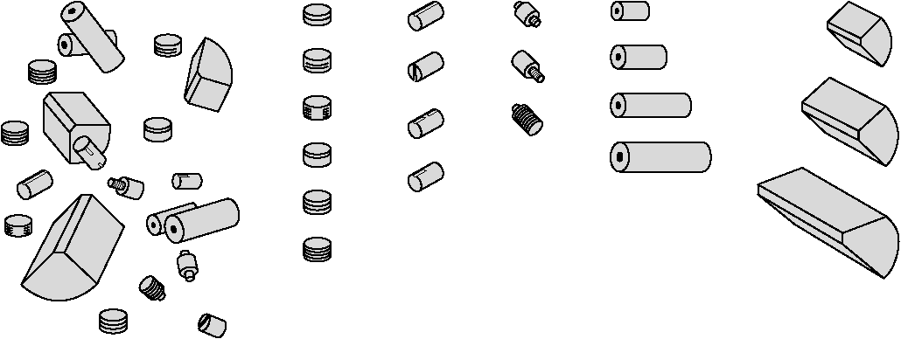
Group Technology Scheme
(b) Grouped Cylindrical Parts (families of parts)
(a) Ungrouped Parts
Grooved Slotted Threaded Drilled Machined
Figure 5.10

Slide 66
Group Technology Benefits
Improved design
Reduced raw material and purchases
Simplified production planning and control
Improved layout, routing, and machine loading
Reduced tooling setup time, work-in-process, and production time

Slide 67
Documents for Production
Assembly drawing
Assembly chart
Route sheet
Work order
Engineering change notices (ECNs)

Slide 68
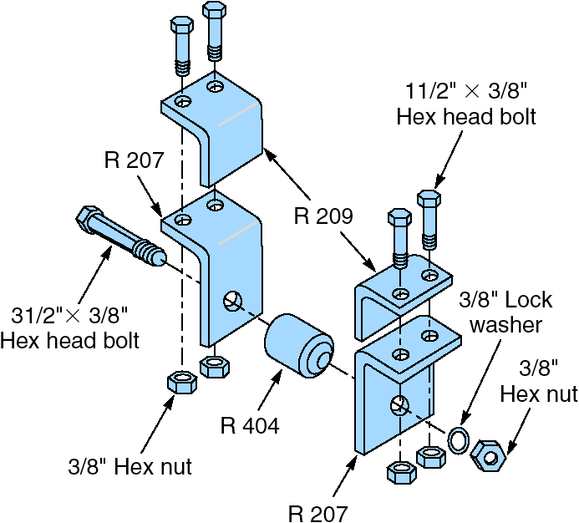
Assembly Drawing
Shows exploded view of product
Details relative locations to show how to assemble the product
Figure 5.11 (a)

Slide 69
Assembly Chart
1
R 209 Angle
R 207 Angle
Left bracket
assembly
Identifies the point of production where components flow into subassemblies and ultimately into the final product
2
SA 1
A1
Bolts w/nuts (2)
3
R 209 Angle
4
R 207 Angle
Right bracket
assembly
5
SA 2
A2
Bolts w/nuts (2)
6
Bolt w/nut
7
R 404 Roller
8
A3
Lock washer
Poka-yoke inspection
9
Part number tag
10
A4
Box w/packing material
Figure 5.11 (b)
11
A5

Slide 70
Route Sheet
Lists the operations and times required to produce a component
Setup Operation
Process Machine Operations Time Time/Unit
1 Auto Insert 2 Insert Component 1.5 .4 Set 56
2 Manual Insert Component .5 2.3 Insert 1 Set 12C
3 Wave Solder Solder all 1.5 4.1 components to board
4 Test 4 Circuit integrity .25 .5 test 4GY

Slide 71
Work Order
Instructions to produce a given quantity of a particular item, usually to a schedule
Work Order
Item Quantity Start Date Due Date
Production Delivery
Dept Location
157C 125 5/2/19 5/4/19
F32 Dept K11

Slide 72
Engineering Change Notice (ECN)
A correction or modification to a product’s definition or documentation
Engineering drawings
Bill of material
Quite common with long product life cycles, long manufacturing lead times, or rapidly changing technologies

Slide 73
Configuration Management
The need to manage ECNs has led to the development of configuration management systems
A product’s planned and changing components are accurately identified
Control and accountability for change are identified and maintained

Slide 74
Product Life-Cycle Management (PLM)
Integrated software that brings together most, if not all, elements of product design and manufacture
Product design
CAD/CAM
DFMA
Product routing
Materials
Layout
Assembly
Maintenance
Environmental

Slide 75
Service Design
Many aspects of services are intangible
Service typically includes direct interaction with the customer
Service productivity is notoriously low partially because of customer involvement in the design or delivery of the service, or both
Complicates product design

Slide 76
Designing More Efficient Services
Limit the options
Improves efficiency and ability to meet customer expectations
Delay customization
Modularization
Eases customization of a service

Slide 77
Designing More Efficient Services
Automation
Reduces cost, increases customer service
Moment of truth
Critical moments between the customer and the organization that determine customer satisfaction

Slide 78
Documents for Services
High levels of customer interaction necessitate different documentation
Often explicit job instructions
Scripts and storyboards are other techniques

Slide 79
First Bank Corp. Drive-up Teller Service Guidelines
Say “please” and “thank you” in all conversations.
Be discrete when speaking into the microphone as others may hear the conversation.
Give customers written instructions if they need to fill out forms you give them.
Look directly at customers if there is a line of sight.
If the customer needs to park and enter the bank, apologize for the inconvenience.

Slide 80
Application of Decision Trees to Product Design
Particularly useful when there are a series of decisions and outcomes that lead to other decisions and outcomes

Slide 81
Application of Decision Trees to Product Design
Procedure
Include all possible alternatives and states of nature – including “doing nothing”
Enter payoffs at end of branch
Determine the expected value of each branch and “prune” the tree to find the alternative with the best expected value

Slide 82
Decision Tree Example
(.4)
High sales
Purchase CAD
(.6) Low sales
Hire and train engineers
(.4)
High sales
(.6)
Low sales
Do nothing
Figure 5.12

Slide 83
Decision Tree Example
(.4)
High sales
$2,500,000 Revenue
– 1,000,000 Mfg cost ($40 x 25,000)
– 500,000 CAD cost
$1,000,000 Net
Purchase CAD
(.6) Low sales
$800,000 Revenue
– 320,000 Mfg cost ($40 x 8,000)
– 500,000 CAD cost
– $20,000 Net loss
Hire and train engineers
(.4)
High sales
EMV (purchase CAD system) = (.4)($1,000,000) + (.6)(– $20,000)
(.6)
Low sales
Do nothing
Figure 5.12

Slide 84
Decision Tree Example
(.4)
High sales
$2,500,000 Revenue
– 1,000,000 Mfg cost ($40 x 25,000)
– 500,000 CAD cost
$1,000,000 Net
Purchase CAD
$388,000
(.6) Low sales
$800,000 Revenue
– 320,000 Mfg cost ($40 x 8,000)
– 500,000 CAD cost
– $20,000 Net loss
Hire and train engineers
(.4)
High sales
EMV (purchase CAD system) = (.4)($1,000,000) + (.6)(– $20,000)
= $388,000
(.6)
Low sales
Do nothing
Figure 5.12

Slide 85
Decision Tree Example
(.4)
High sales
$2,500,000 Revenue
– 1,000,000 Mfg cost ($40 x 25,000)
– 500,000 CAD cost
$1,000,000 Net
Purchase CAD
$388,000
(.6) Low sales
$800,000 Revenue
– 320,000 Mfg cost ($40 x 8,000)
– 500,000 CAD cost
– $20,000 Net loss
Hire and train engineers
$365,000
(.4)
High sales
$2,500,000 Revenue
– 1,250,000 Mfg cost ($50 x 25,000)
– 375,000 Hire and train cost
$875,000 Net
(.6)
Low sales
$800,000 Revenue
– 400,000 Mfg cost ($50 x 8,000)
– 375,000 Hire and train cost
$25,000 Net
Do nothing $0
$0 Net
Figure 5.12

Slide 86
Transition to Production
Know when to move to production
Product development can be viewed as evolutionary and never complete
Product must move from design to production in a timely manner
Most products have a trial production period to insure producibility
Develop tooling, quality control, training
Ensures successful production

Slide 87
Transition to Production
Responsibility must also transition as the product moves through its life cycle
Line management takes over from design
Three common approaches to managing transition
Project managers
Product development teams
Integrate product development and manufacturing organizations

Slide 88
